Slide 1
3D Face Reconstruction
Arnaud Lhomme, s2397447
Ángel Lorente Rogel, s2413159
Guillermo Rodríguez, s2421771

Slide 2


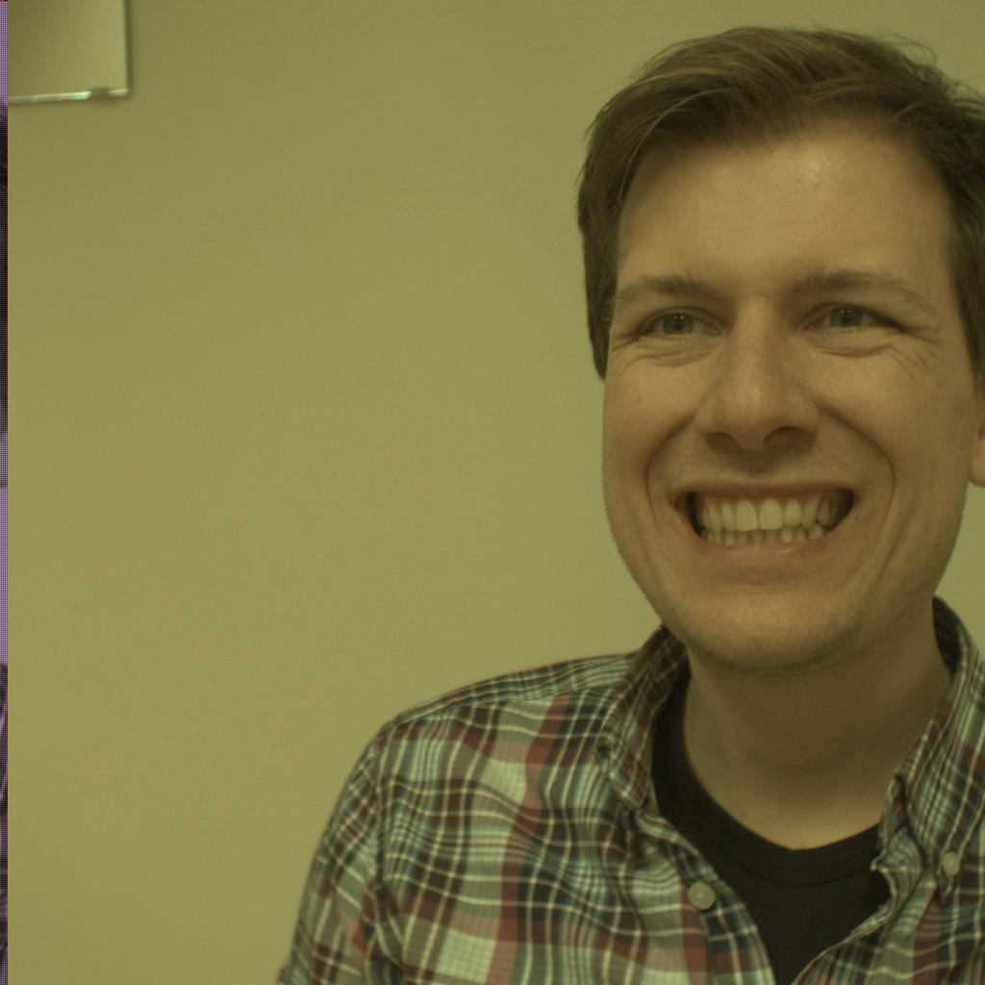
Goal
Design a method for the creation of the 3D surface meshes of the faces of subjects

Slide 3
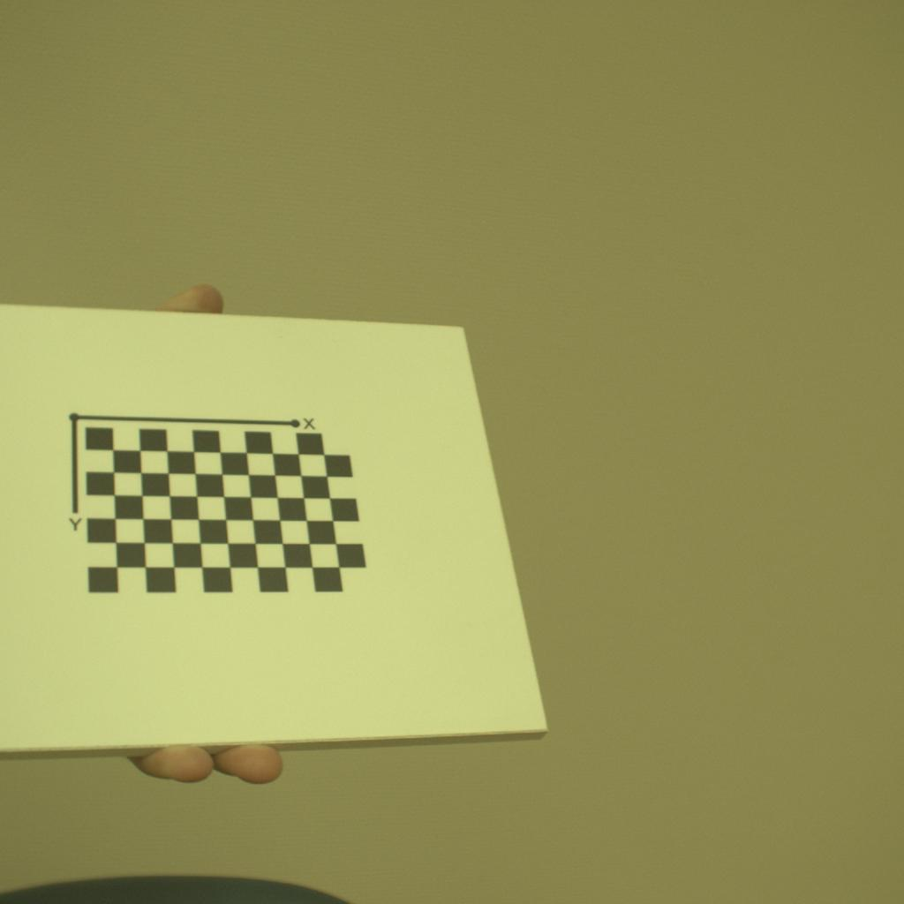
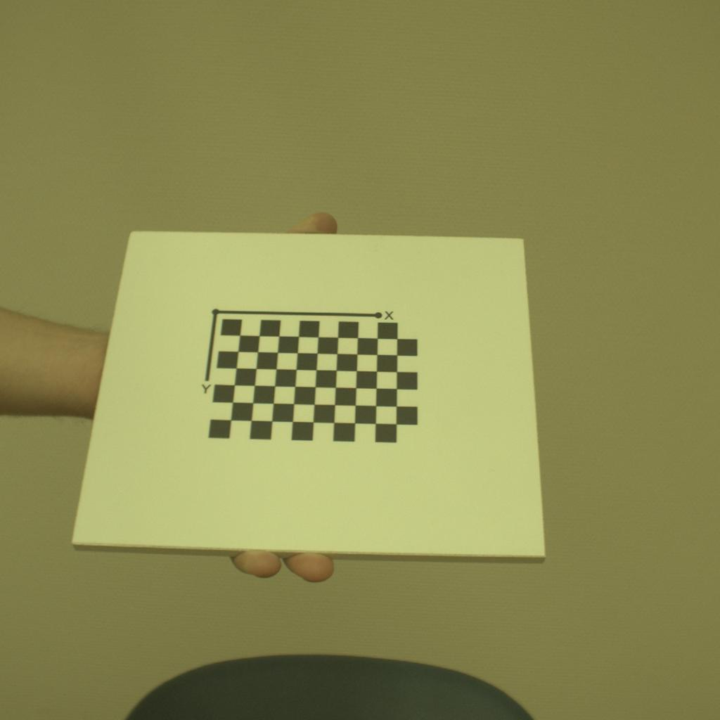
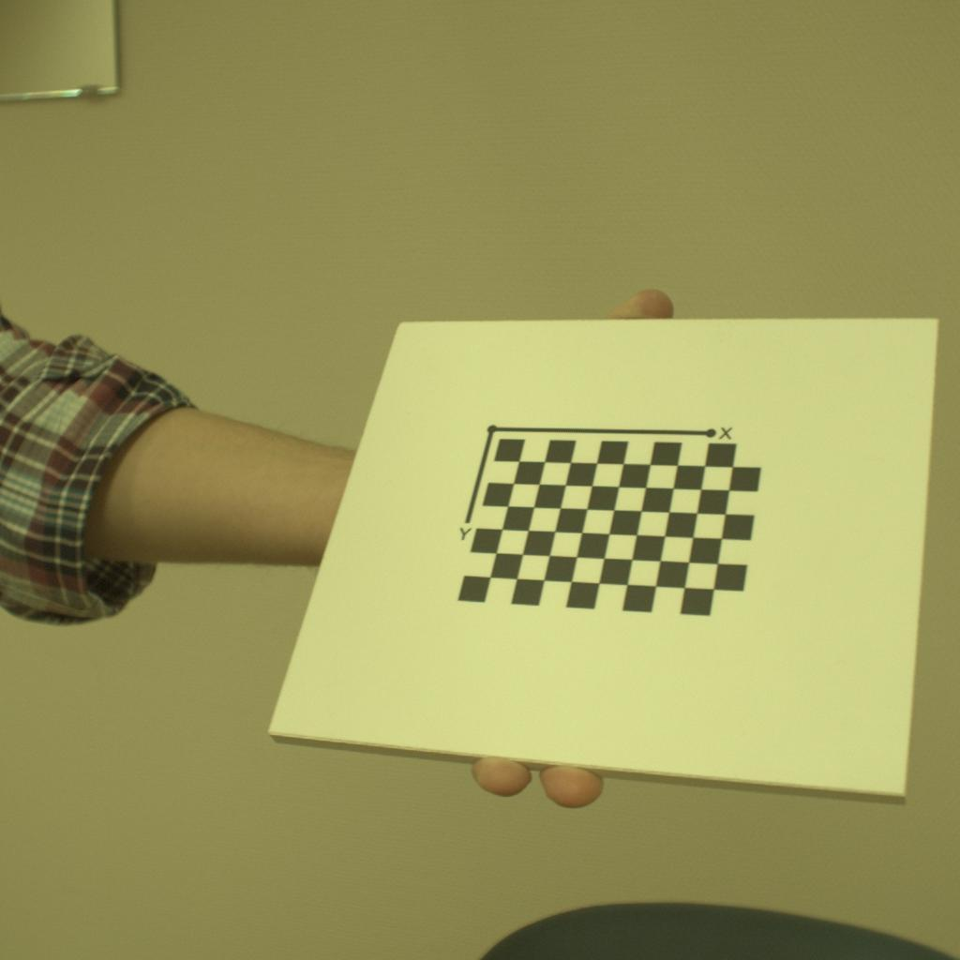
Stereo Camera Calibration
Two calibrations
Multiple correspondences, intrinsic camera parameters, rotation and translation
Remove the error (reprojection)

Slide 4
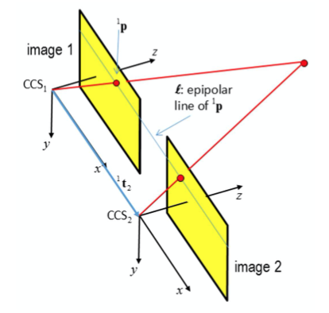
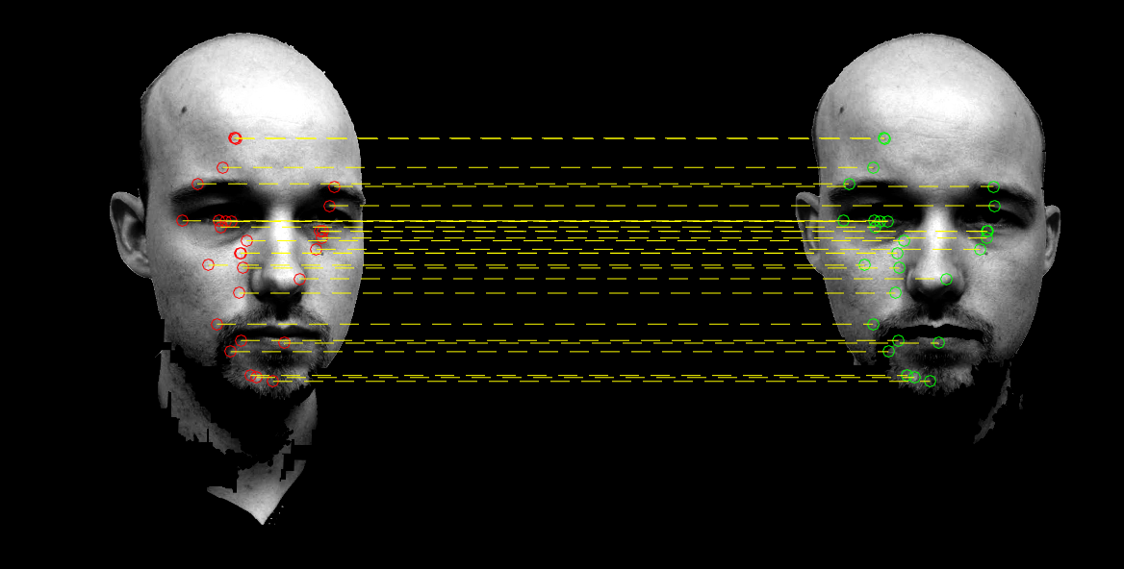
Stereo Rectification
In practice cameras not aligned
Virtual rotation and change in matrices
Same orientation of the cameras
Horizontal base line
Two optical axes orthogonal to base line

Slide 5

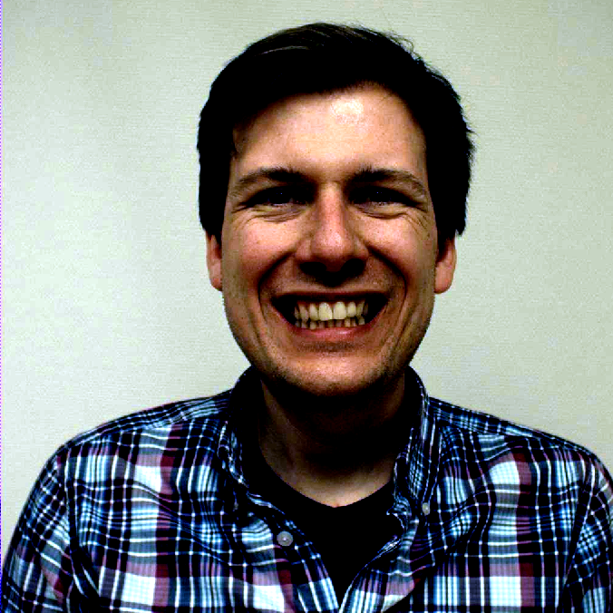
Colour Normalization

Slide 6
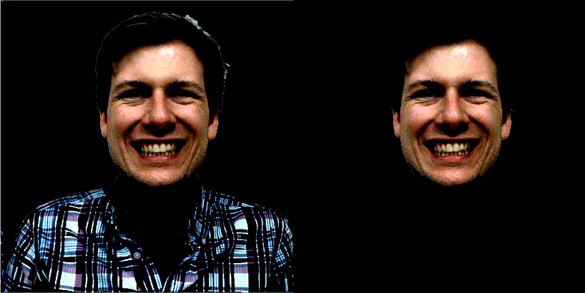
Face Detection
Background removal with edge detection algorithm
Face extraction with skin detection algorithm

Slide 7
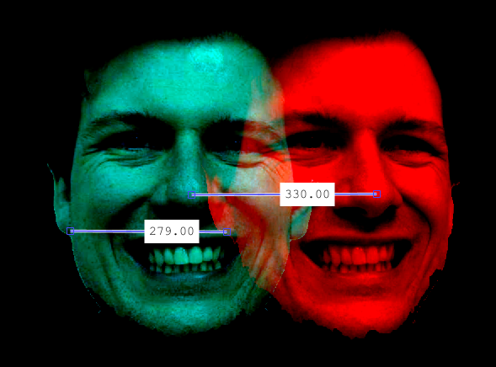
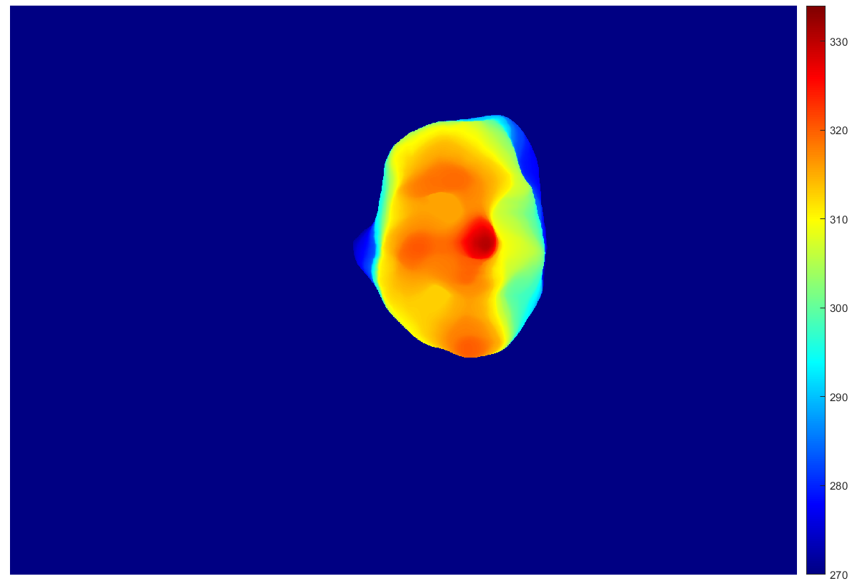
Disparity Maps
Disparity range obtained graphically
Disparity map created with Semi-Global Matching algorithm

Slide 8
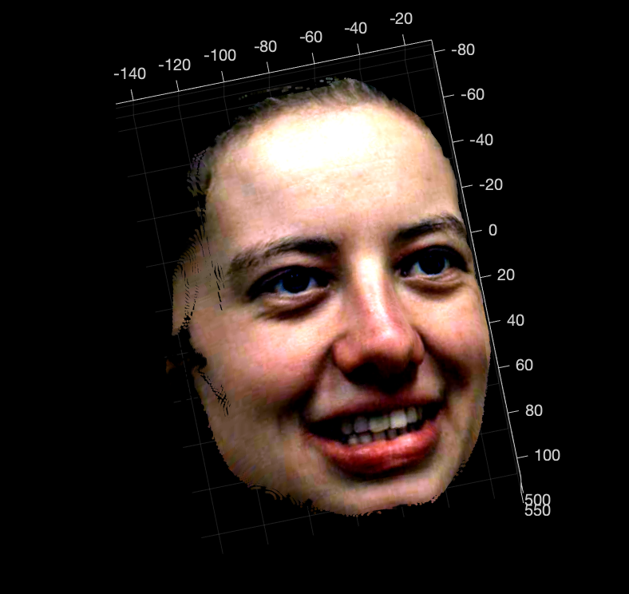
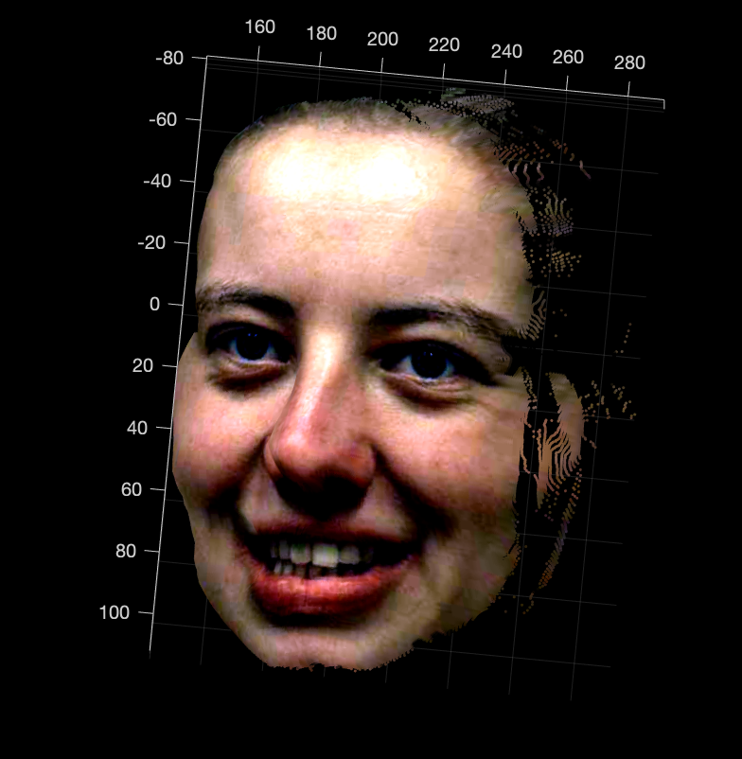
3D Point Clouds
Input: Disparity map, calibration parameters
Result: For each disparity we get the 3D coord. of the reconstruction
Points close to each other
MATLAB pointCloud

Slide 9
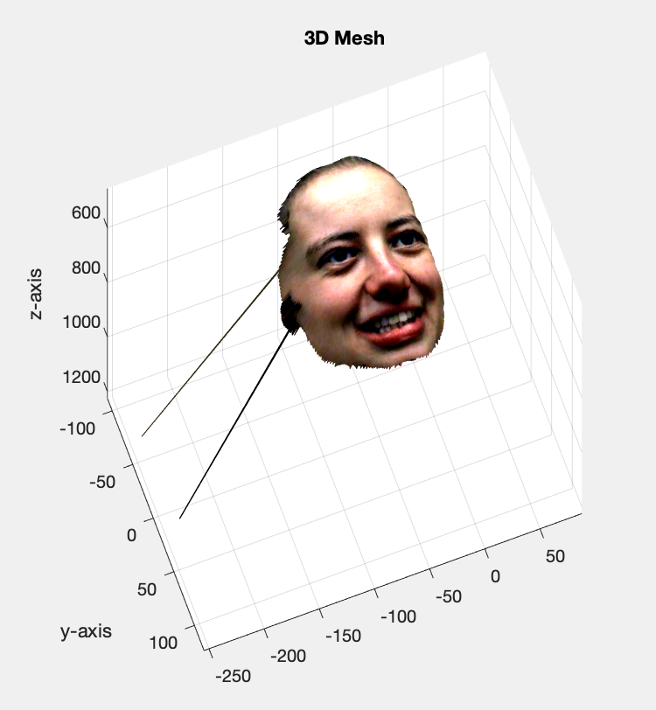
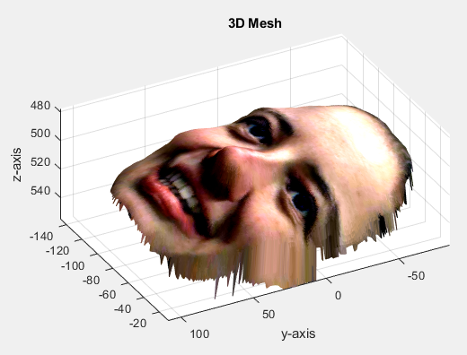
3D Mesh Reconstruction
Combination of adjacent triangles
Orthogonal view of image
Divide each pixel area into two triangles
Remove unreliable point triangles
Relation between 2D points with disparity map

Slide 10
Conclusion

